Slide 1

Advanced Big Data:
Apache Spark for Data Processing and Machine Learning
Dan Zaratsian
AI & Machine Learning Engineer @ Google
d.zaratsian@gmail.com
https://github.com/zaratsian

Slide 2


TOPICS
Session 1: Intro Big Data Architectures and Services
Session 2: SQL and NoSQL
Session 3: Spark ML
Session 4: Real-Time Streaming Analytics
Session 5: Serverless Technology
Session 6: Cloud Machine Learning and Deployments

Slide 3

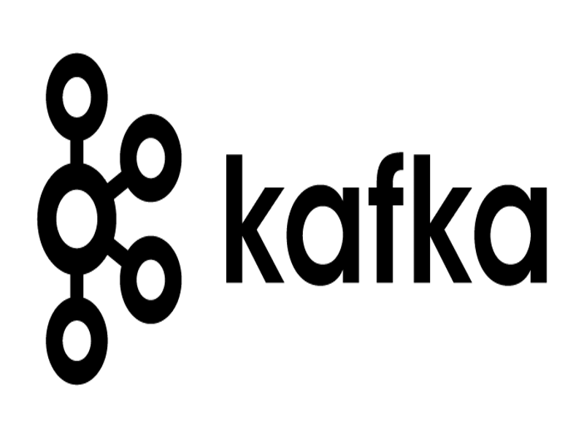











Next up...
Session 2
SQL & NoSQL
Session 3
Spark
Session 4
AI Platform
Session 5
Streaming
Session 6
Cloud
ML
Serverless
AI Platform
GCP PubSub
SQL
Notes:
Use Finance
Use Case for streaming asset data from a market data provider into trading and analytic systems
Live streaming data via a simple API. Published live market data from Thomson Reuters onto Pub/Sub
Consuming almost 1,000 assets from Reuters
Used Dataflow to help manage a distributed stream calculation engine
Put data into time-series windows to perform analysis
Ran correlations at regular time-intervals
About million correlations at a given time for calculation
No problem scaling to meet data demands
Wrote results to BigQuery and Pub/Sub for consumers
Traders utilized the trading system consuming the data to make decisions
Data Analysts would analyze trends over time in Tableau and Datalab

Slide 4
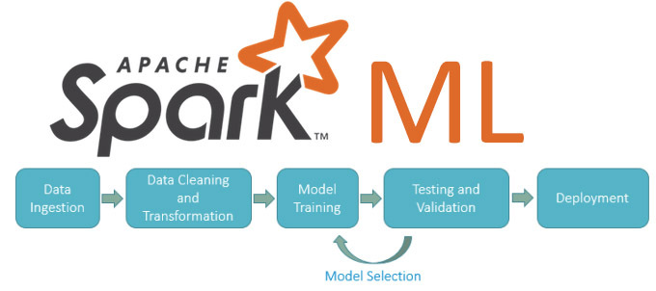

Slide 5

Apache Spark
In-Memory compute for ETL, Analytics, and Machine Learning
Scala, Java, Python, and R APIs
Libraries:
SparkSQL
Spark Streaming & Structured Streaming
GraphX
Spark ML

Slide 6
PySpark Example: Importing Data into DataFrame
RDD to DataFrame
(older way of doing it)
Direct to DataFrame
(recommended)
rdd = sc.textFile("/tmp/airlines.csv") \
.map(lambda x: x.split(","))
header = rdd.take(1)
df = rdd.filter(lambda x: x!=header[0]) \
.toDF(header[0])
df = rawdata = spark.read.load('/tmp/airlines.csv', format="csv", header=True, inferSchema=True)
* Infer schema takes more time.
Pre-define your schema if speed is a concern.

Slide 7
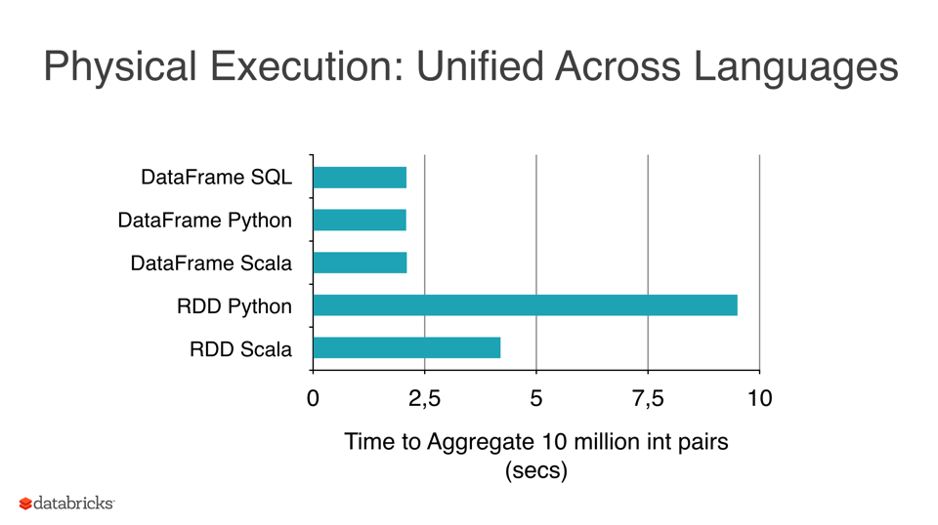

Slide 8

2009 (UC Berkeley)
In-Memory computing (speed)
2010 (Open Sourced)
Distributed, cluster computing
2013 (Apache Project)
2015-03 (Spark 1.3)
Machine Learning
…
Flexible Data Processing
2016-01 (Spark 1.6)
Multiple APIs
2016-07 (Spark 2.0)
2020-02 (Spark 2.4.5)

Slide 9
Spark SQL - Integration
Tableau
JDBC / ODBC
Notebooks
Shell
REST API
Spark
Hive
JSON
S3
…

Slide 10
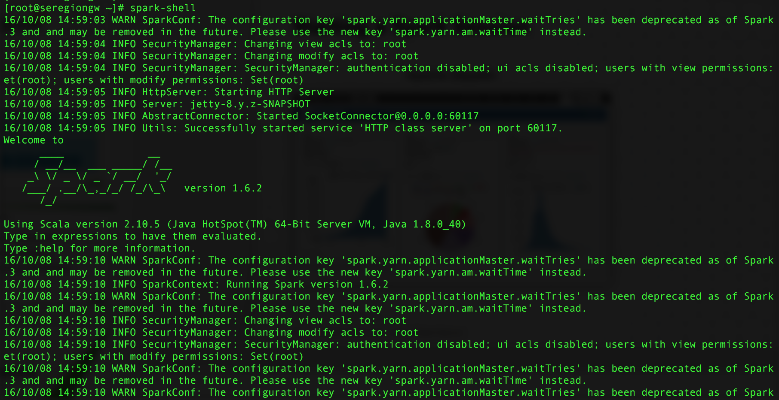
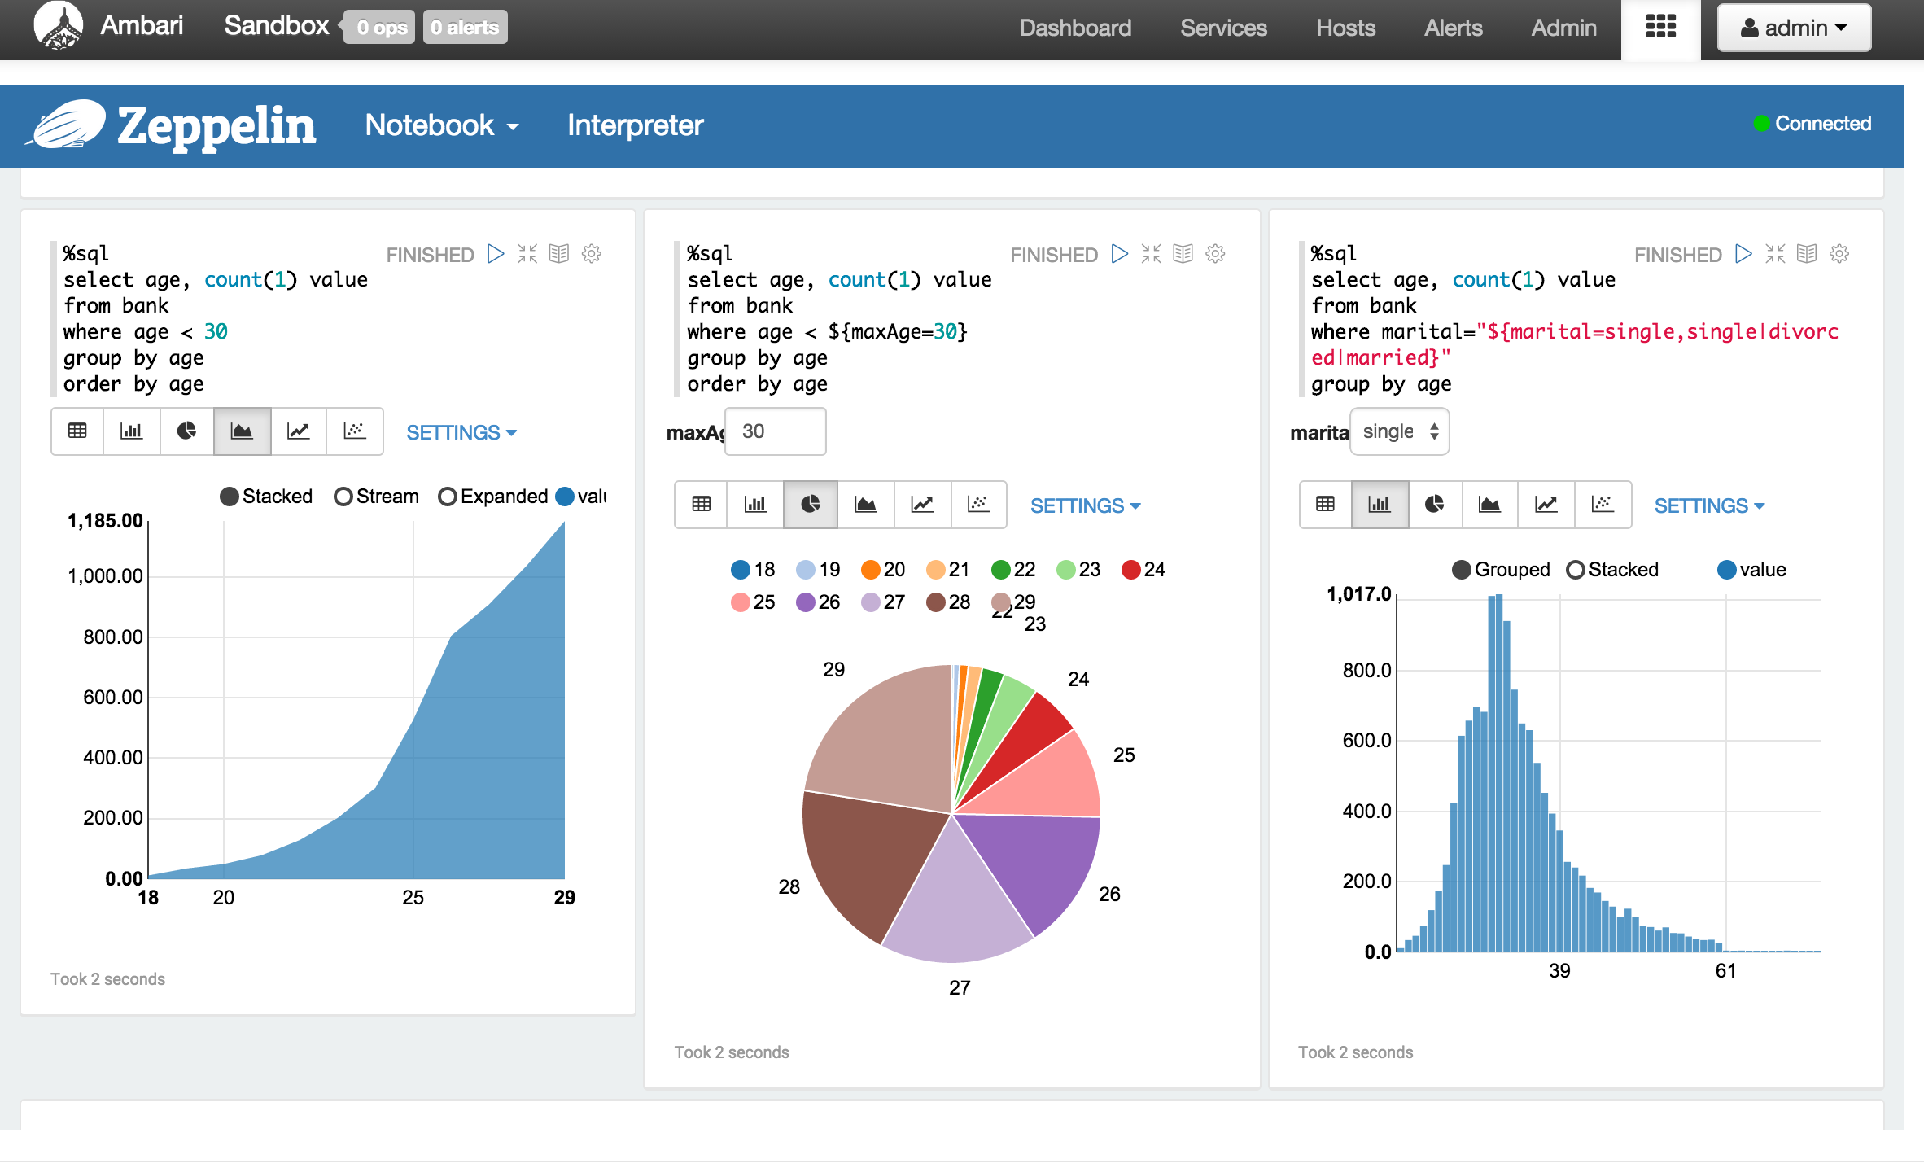
Starting a Spark Session
Apache Zeppelin
./bin/spark-shell
./bin/pyspark
./bin/sparkr
./bin/spark-sql
./bin/spark-submit
./bin/spark-submit --master yarn --deploy-mode cluster --executor-memory 20G --num-executors 50 /path/to/my_pyspark.py

Slide 11
What happens when you submit a Spark Job
Worker Node
Executor
Cache
Client Node
Task
Task
Driver Program
Resource Manager
(YARN)
Spark Context
Worker Node
Master:
Yarn
Local[*]
Standalone: spark://host:port
Executor
Cache
Submit Spark Job
in Yarn-Client Mode
Task
Task

Slide 12

Spark Machine Learning
Machine Learning Library (MLlib)
Library Includes:
ML Algorithms: Classification, regression, clustering, and collaborative filtering (recommender)
Featurization: Feature extraction, transformation, dimensionality reduction
Pipelines: Tools for constructing, evaluating, and tuning ML Pipelines
Persistence: Saving and load algorithms, models, and Pipelines
Utilities: Linear algebra, statistics, data handling, etc.

Slide 13
Vectors
Dense Vector is backed by a double array representing its entry values
Sparse Vector is backed by two parallel arrays (used when many values are zero)
Example: (1.0, 0.0, 3.0)
Dense: Vectors.dense(1.0, 0.0, 3.0)
Sparse: Vectors.sparse(3, [(0, 2), (1.0,3.0)])

Slide 14
Spark ML Pipelines
Make it easier to combine multiple algorithms into a single workflow.
Sequence of stages, and each stage is either a Transformer or an Estimator.
Core Components of a Pipeline:
DataFrame: ML dataset
Transformer: Transforms one DataFrame into another DataFrame
Estimator: Algorithm which can be fit on a DataFrame to produce a Transformer. E.g., a learning algorithm is an Estimator which trains on a DataFrame and produces a model.
Pipeline: A Pipeline chains multiple Transformers and Estimators together to specify an ML workflow.
Parameter: All Transformers and Estimators now share a common API for passing/specifying parameters.

Slide 15
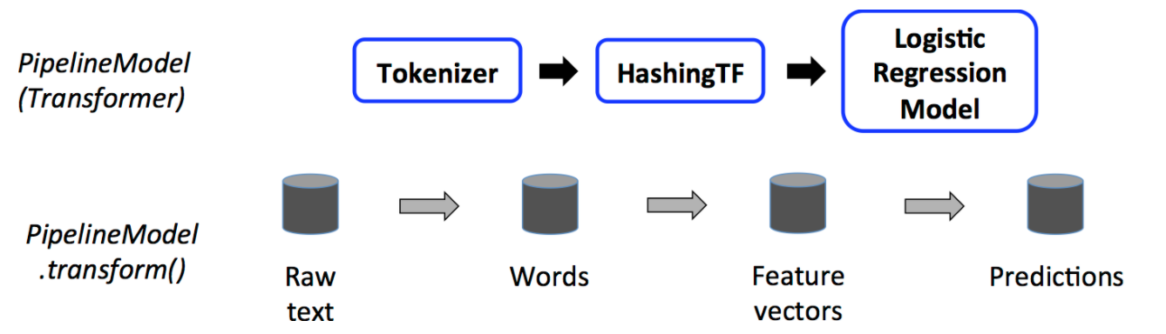
Spark Machine Learning

Slide 16
Spark ML Pipeline
In machine learning, it is common to run a sequence of algorithms. We can bundle these algorithms and data processing steps into a Spark ML Pipeline.
A Pipeline is specified as a sequence of stages, and each stage is either a Transformer or an Estimator. The stages are specified as an ordered array (or DAG).
It's often a best practice to save a model or a pipeline to disk for later use.
Reference Code (in Colab Notebook): Spark ML Pipeline Example

Slide 17
Spark ML Feature Engineering
Extracting, transforming and selecting features:
Feature Extractors: TF-IDF, Word2Vec
Feature Transformers: PCA, StopWordsRemover, StringIndexer, OneHotEncoderEstimator, Bucketizer, VectorAssember
Feature Selectors: VectorSlicer, RFormula, ChiSqSelector
Locality Sensitive Hashing: Approximate Nearest Neighbor Search, MinHash for Jaccard Distance

Slide 18
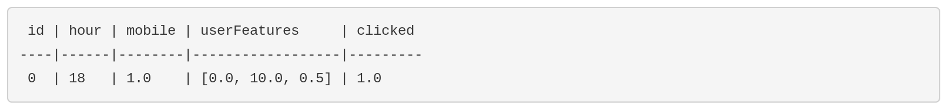
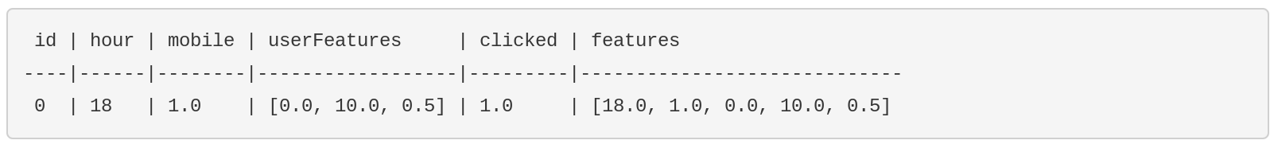
Spark VectorAssembler
Transformer that combines a list of columns into a single vector column.
Useful for combining raw features and features generated by different feature transformers into a single feature vector, in order to train ML models.
VectorAssembler(inputCols=["hour", "mobile", "userFeatures"], outputCol="features")

Slide 19
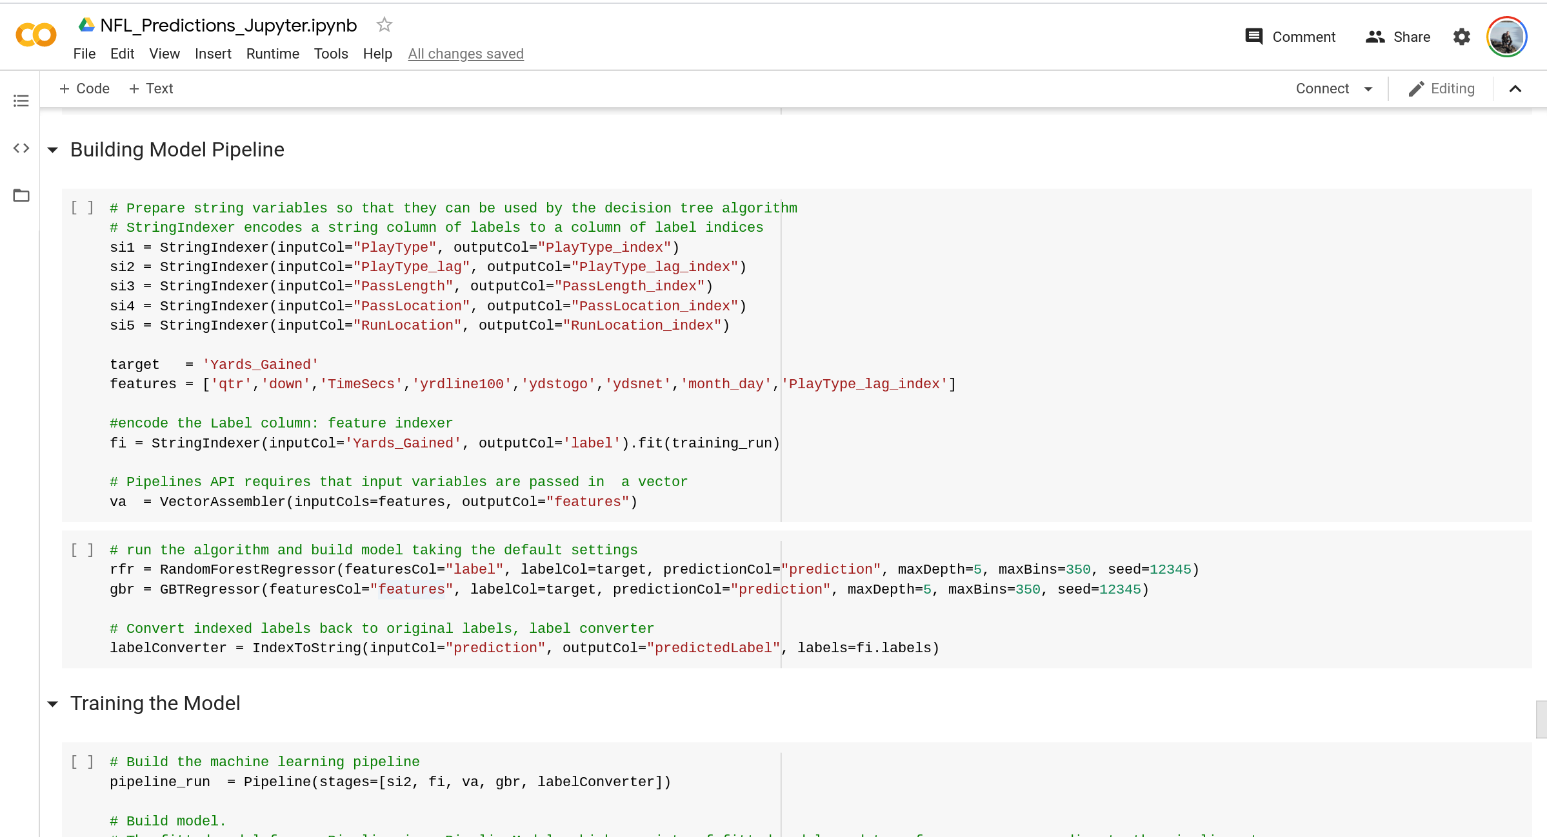

Slide 20
ML Algorithms
Classification Techniques
Logistic regression
Binomial logistic regression
Multinomial logistic regression
Decision tree classifier
Random forest classifier
Gradient-boosted tree classifier
Multilayer perceptron classifier
Linear Support Vector Machine
One-vs-Rest classifier (a.k.a. One-vs-All)
Naive Bayes
Regression Techniques
Linear regression
Generalized linear regression
Available families
Decision tree regression
Random forest regression
Gradient-boosted tree regression
Survival regression
Isotonic regression
Mixed Techniques
Decision trees
Inputs and Outputs
Input Columns
Output Columns
Random Forests
Inputs and Outputs
Input Columns
Output Columns
Gradient-Boosted Trees (GBTs)
Inputs and Outputs
Input Columns
Output Columns

Slide 21
Algorithms
Clustering Techniques
K-means
Input Columns
Output Columns
Latent Dirichlet allocation (LDA)
Bisecting k-means
Gaussian Mixture Model (GMM)
Input Columns
Output Columns
Collaborative Filtering / Recommendation Techniques
Explicit vs. implicit feedback
Scaling of the regularization parameter
Cold-start strategy
Advanced Algorithms
FP-Growth (Pattern Mining)
PrefixSpan
Optimization of linear methods (developer)
Limited-memory BFGS (L-BFGS)
Normal equation solver for weighted least squares
Iteratively reweighted least squares (IRLS)

Slide 22
Model Selection and Hyperparameter Tuning
Techniques:
Model selection (hyperparameter tuning)
ParamGridBuilder - Used to construct the parameter grid. By default, sets of parameters from the parameter grid are evaluated in serial. Parameter evaluation can be done in parallel by setting parallelism with a value of 2 or more. (10 should be sufficient for most clusters).
Cross-Validation - Splits the dataset into a set of folds which are used as separate training and test datasets. For example, with k=3 folds, CrossValidator will generate 3 (training, test) dataset pairs, each of which uses 2/3 of the data for training and 1/3 for testing.
Train-Validation Split - Only evaluates each combination of parameters once, as opposed to k times in the case of CrossValidator. It is, therefore, less expensive, but will not produce as reliable results.

Slide 23
Best Practices: Dev
Use DataFrames instead of RDDs
Use schema inference (if speed is not critical)
Scala, Java, Python, R… Which one to use?
Read release notes - APIs change frequently
Use a notebook like Zeppelin or Jupyter for Dev
Spark is memory sensitive (dev against small samples)
Changes to the code, num-executors, executor-memory, driver-memory?
Restricting size separates functions and scale concerns

Slide 24
Best Practices: Tuning
Understand how Spark works...
Spark transformations create new RDDs, but not executed until action is called
Data is distributed, so predefine your partitions or understand how your computations are executed
Understand your application…
ML is CPU intensive
ETL is I/O intensive
Cache/persist commonly used data
Use Broadcast variables (read-only variable cached on each machine rather than shipping a copy of it with tasks)

Slide 25
Best Practices: Tuning
Avoid .collect() where possible
use .take(x) instead, or write results directly to HDFS, Hive, etc.
Executor-memory
Anything over ~20GB could cause garbage collection issues
Increase num-executors instead
Num-executors
Do not exceed your total core count
Spark History UI -> Exectors -> Grid
Enable Dynamic Allocation (disabled by default)
Dynamically adjusts the resources your application occupies based on the workload

Slide 26
Demos

Slide 27

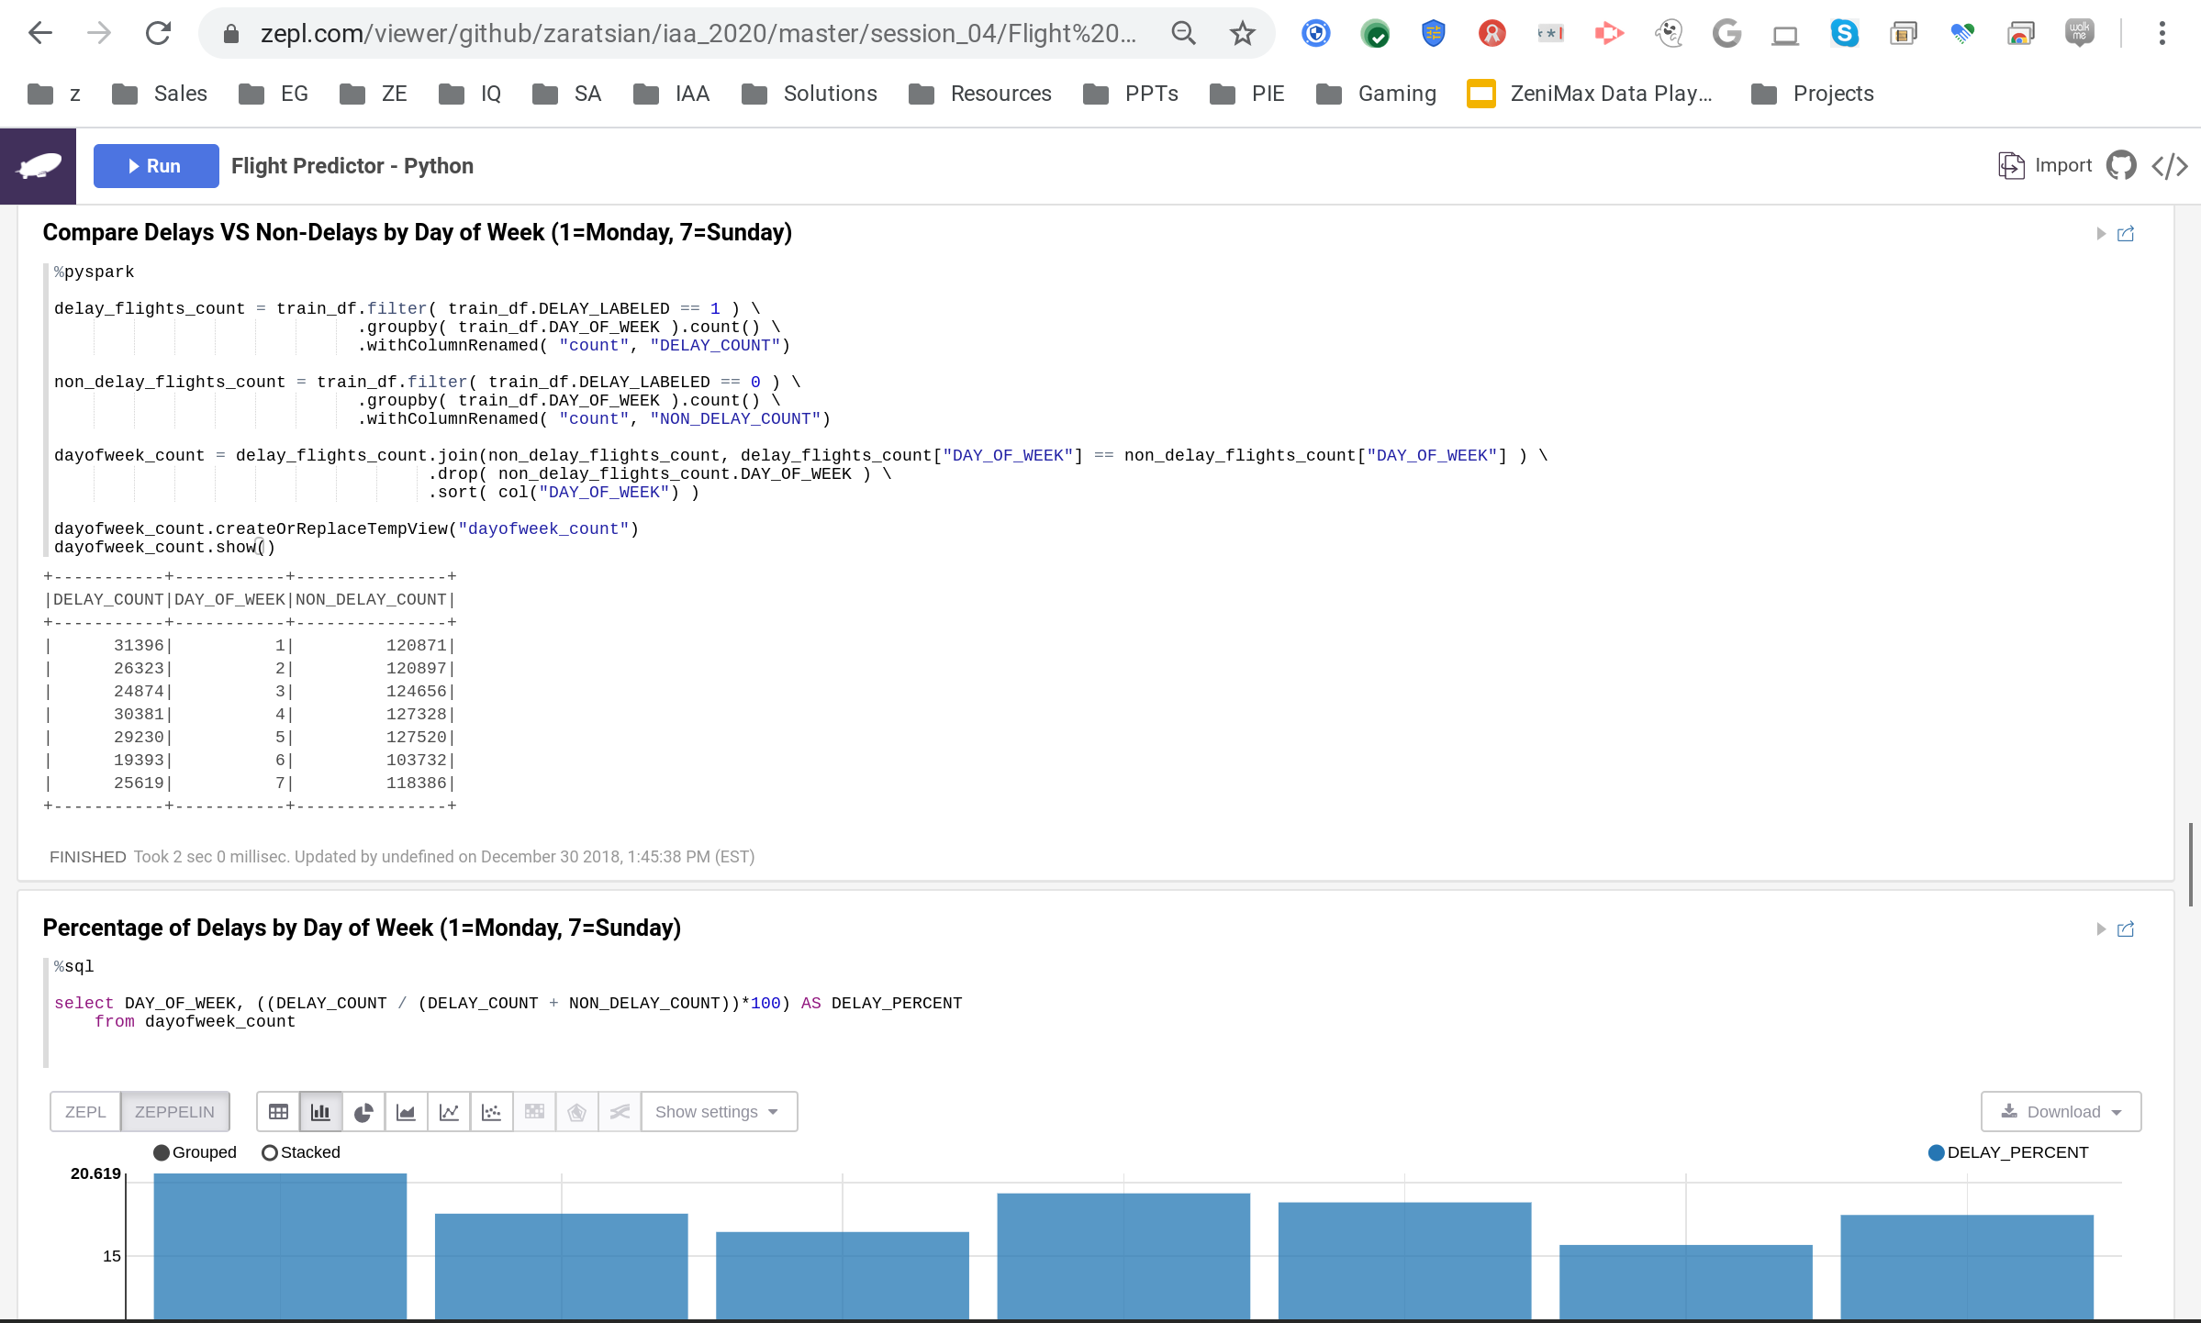
Demos
Apache Zeppelin Online Viewer: https://www.zepl.com/explore
Zeppelin Notebook

Slide 28
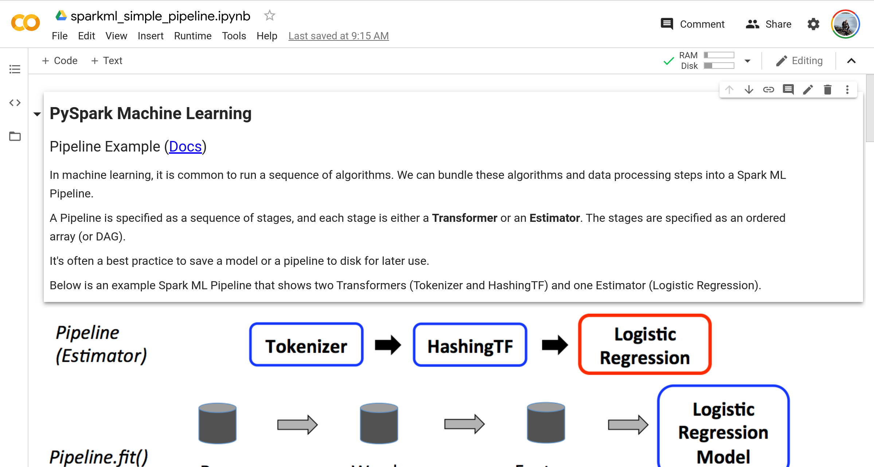

Demos
Google Colab
ML Pipelines Basic Example

Slide 29
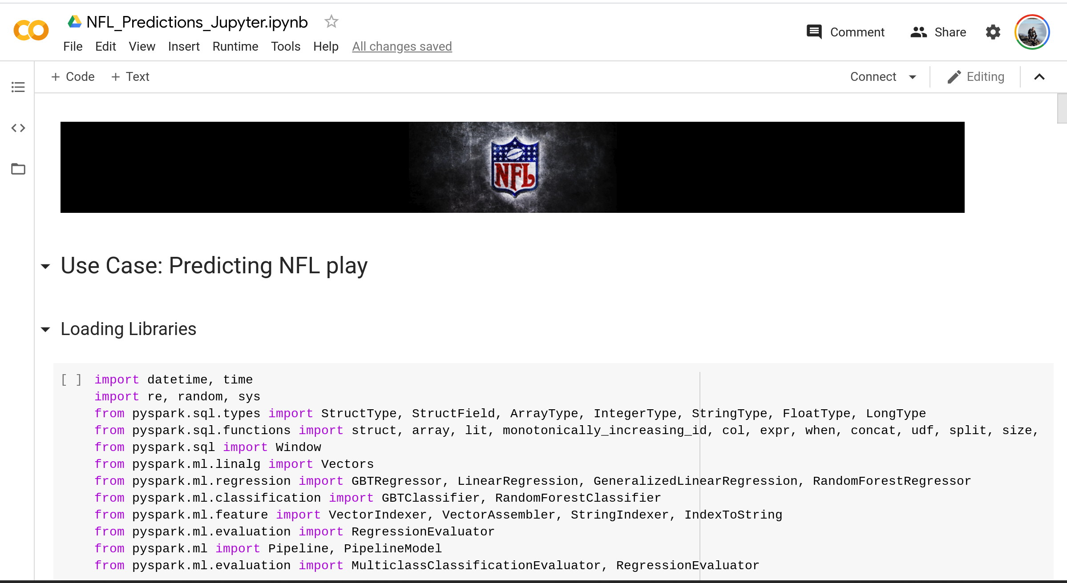
Demos
Google Colab
NFL Predictions Notebook

Slide 30
Misc Slides - Appendix

Slide 31
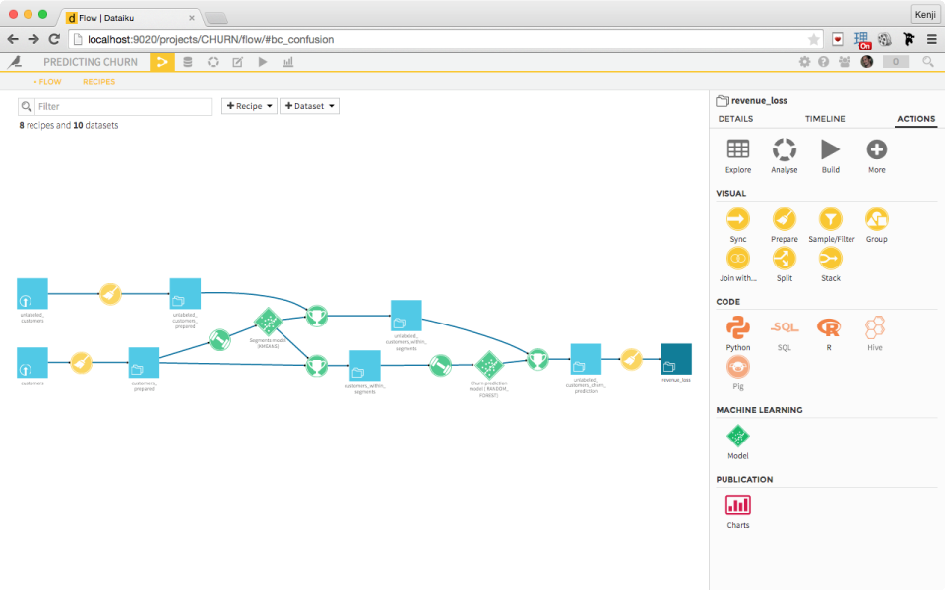




Data Science Landscape
Code-based Tools
Drop-and-Drag Tools

Slide 32
Apache Spark - Example
mm_season = spark.read.load(
"hdfs://sandbox.hortonworks.com:8020/tmp/marchmadness/SeasonResults/SeasonResults.csv",
format="csv",
header=True)
mm_season.show()
mm_season.count()
mm_season.dtypes
mm_season.createOrReplaceTempView('mm_season_sql')
spark.sql('''SELECT * FROM mm_season_sql ''').show(10)

Slide 33
Apache Spark - Recommendations
1. Caching: • MEMORY_ONLY: (default/recommended) Store RDD as deserialized objects in JVM Heap • MEMORY_ONLY_SER: (2nd option) Store RDD as serialized Kryo objects. Trade CPU time for memory savings • MEMORY_AND_DISK: Spill to disk if can’t fit in memory • MEMORY_AND_DISK_SER: Spill serialized RDD to disk if it can’t fit in memory 2. Data Serialization Performance: • Reduces data size, so less data transfer • Use Kyro over Java (Kyro is up to 10x faster) • conf.set(“spark.serializer”, “org.apache.spark.serializer.KryoSerializer”) • sparkConf.set("spark.sql.tungsten.enabled", "true") • sparkConf.set("spark.io.compression.codec", "snappy") • sparkConf.set("spark.rdd.compress", "true") 3. Memory and Garbage Collection Tuning: • GC is a problem for Spark apps which churn RDDs • Measure time spent in GC by logging: -verbose:gc –XX:+PrintGCDetails –XX:+PrintGCTimeStamps • If there’s excessive GC per task, use the MEMORY_ONLY_SER storage level to limit just one object per RDD partition (one byte array) and reduce the spark.storage.memoryFraction value from 0.6 to 0.5 or less. 4. Set Correct Level of Parallelism: • set spark.default.parallelism = 2-3 tasks per CPU core in your cluster • Normally 3 - 6 executors per node is a reasonable, depends on the CPU cores and memory size per executor • sparkConf.set("spark.cores.max", "4") • 5 or less cores per executor (per node) (ie. 24-core node could run 24/4cores = 6 executors)

Slide 34
Best Practices: Dev
Use DataFrames instead of RDDs
Use schema inference (especially if speed is not critical)
Scala, Java, Python, R… Which one to use?
Read release notes - APIs change frequently
Use a notebook like Zeppelin or Jupyter for Dev
Spark is memory sensitive (dev against small samples)
Changes to the code, num-executors, executor-memory, driver-memory?
Restricting size separates functions and scale concerns

Slide 35
Best Practices: Tuning
Understand how Spark works...
Spark transformations create new RDDs, but not executed until action is called
Data is distributed, so predefine your partitions or understand how your computations are executed
Understand your application…
ML is CPU intensive
ETL is I/O intensive
Cache/persist commonly used data
Use Broadcast variables (read-only variable cached on each machine rather than shipping a copy of it with tasks)

Slide 36
Best Practices: Tuning
Avoid .collect() where possible
use .take(x) instead, or write results directly to HDFS, Hive, etc.
Executor-memory
Anything over ~20GB could cause garbage collection issues
Increase num-executors instead
Num-executors
Do not exceed your total core count
Spark History UI -> Exectors -> Grid
Enable Dynamic Allocation (disabled by default)
Dynamically adjusts the resources your application occupies based on the workload

Slide 37
Configuring Executors
executor-memory
Should be between 8GB and 64GB
executor-cores
At least 2, max 4
num-executors
This is the most flexible
If caching data, desirable to have datasize * 2 as the total application memory
EXAMPLE: YARN nodes with 128GB and 16 cores available would support a relatively common 16GB-memory / 2-core executor size
If caching a 100GB dataset, 13 executors could be ideal

Slide 38
Which Storage Level to Choose?
If the RDD fits in memory, use the default MEMORY_ONLY
If RDDs are too big, try MEMORY_ONLY_SER with a fast serialization library (Scala only)
If the RDDs are still too big:
Consider the time to compute this RDD from parent RDD vs the time to load it from disk
Re-computing an RDD may sometimes be faster than reading it from disk
Replicated storage is good for fast fault recovery, but…
Usually this is overkill, and not a good idea if you're using a lot of data relative to total memory
For DataFrames, use cache() instead of persist(StorageLevel)

Slide 39
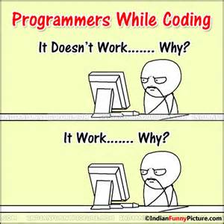
When things go wrong…
Where to look:
yarn application –list (get the list of running application)
yarn logs -applicationId <app_id>
Check Spark: http://<host>:8088/proxy/<job_id>/environment/
Common Issues:
Submitted a Job but nothing happens
Job stays in accepted state when allocated more memory/cores than is available
May need to kill unresponsive/stale jobs
Insufficient HDFS access
Grant user/group necessary HDFS access
May lead to failure such as: “Loading data to table default.testtable Failed with exception Unable to move sourcehdfs://red1:8020/tmp/hive-spark/hive_2015-03-04_12-45-42_404_3643812080461575333-1/-ext-10000/kv1.txt to destination hdfs://red1:8020/apps/hive/warehouse/testtable/kv1.txt”
Wrong host in Beeline, shows error as invalid URL
“Error: Invalid URL: jdbc:hive2://localhost:10001 (state=08S01,code=0)”
Error about closed SQLContext, restart Thirft Server

Slide 40
Advanced Big Data
Thanks!
Dan Zaratsian
AI & Machine Learning Engineer @ Google
d.zaratsian@gmail.com
https://github.com/zaratsian

